Slide 1

Wearable Smart Patches– MVO 1

Slide 2
Agenda
Requirement and Business Overview
Scope Exclusion
Assumptions
Deliverables
Roles and Responsibilities
Risk/Open Items
Commercials
Development And Delivery Timeline
Planned MVOs to follow

Slide 3
Requirement and Business Overview
Narayana Hrudyalaya [NH] has approached Honeywell [HON] to develop together a portable/Health monitoring device with following KPIs:
Continuous monitoring of Vitals at regular Intervals:
Skin Temperature
Body Posture
ECG Data
Respiration Rate
Periodic transmission of the acquired Data to Athma Endpoint Via a DB server that can hold data for 3 days
A battery operated reusable device that can be recharged and be prepared again for use after the operations
It has been mutually agreed over a series of discussions that
NH shall extend their clinical support in verifying and validating data. NH shall test the device on their patients and share reports and feedback .
NH shall Integrate an API interface to receive data from HN designed Server Hosted on NH Premise .
NH to write Logic for calculating Risk scores and creating Reports/notifications
HON to design device and release 3 consecutive MVOs based on features . Each MVO to follow after the first has been successfully Validated and after a Techno commercial agreement for the next one is in place.
HON to share all API communication details between Device and Server , and Server and NH Endpoint.

Slide 4
Scope Exclusion [HON]
Risk Score Calculation
Report Generation
Data Interpretation
Data Validation
Medical Device Certification
Server and DB maintenance. [Source Code will be provided after development]
Any other activity that is not related to Hardware / Firmware development specifically related to the “Smart Patch” device.
Consumable parts like adhesives and electrodes.

Slide 5
Assumptions
Device assumes a healthy RSSI level to be present on areas of Intallation
Expected(-30 dBm to -67 dBm): A strong signal that supports high data rates and performance.
Poor(-67 dBm to -85 dBm): Device may face intermittent connection impacting performance with non reliable data.
Devices are authenticated on the NH network being used and required ports are allowed for communication
After training , NH team takes care of timely Firmware updates of the devices as and when required. HON team to support remotely
NH team to maintain Server and data base after proper KT and handover of source code by HON team.
Nursing staffs do a regular battery charging as per a predefined schedule and monitor LED status for error notifications.
Nursing staffs are trained professionals and are specialized in placing/Installing the ECG electrodes.
ECG –USB Cable provided is used only with the device [Smart Patch].
Enclosure may show color/other Visual impact due to UV exposure over time
Not recommended to be used on Patients with Pace makers and other similar implants. Need to verify the same from NH.

Slide 6
Deliverables
The box shall contain:
Smart patch device 1 unit.
1 ECG-USB Cable.
Double sided adhesive tapes for trial.
User manual
USB Type-C Charger
An in-house developed utility to check Device data and Plot ECG waveform[Not part of the development Project , developed only for developer testing], shared digitally.

Slide 7
Roles and Responsibilities
Honeywell
Narayana
Design & Develop Hardware
Develop Firmware as per MVO specs
Design and Deploy Backend /Server at NH
Device related QA & VnV activities
Design and develop USB- ECG Cables
Periodically Push latest record per device as per User settable Interval
Consume periodic Data received from NH server
Share timely feedback and Reports
Risk Score Calculation
HMS /Patient-ID Integration
Report Generation
Alerts and Notification
Device Certification
Network Infrastructure as per RSSI Heat map
Wearable Smart Patch

Slide 8
Dependencies on NH
Infrastructure Setup
Device Authorization
Server Maintenance
Clinical Validation of Data

Slide 9
Risk Open items
Current Enclosures [ MVO1] are 3D –Printed hence brittle. Will need to handle with Care.
Current enclosure [MVO1] are not IP rated .
Metal part have bonding issues and may not sustain more than a year’s usage.
Longevity Test [End of Life] has not been conducted yet.
Long Usage (Connect- Disconnect) of ECG-USB Cables yet to be done.

Slide 10
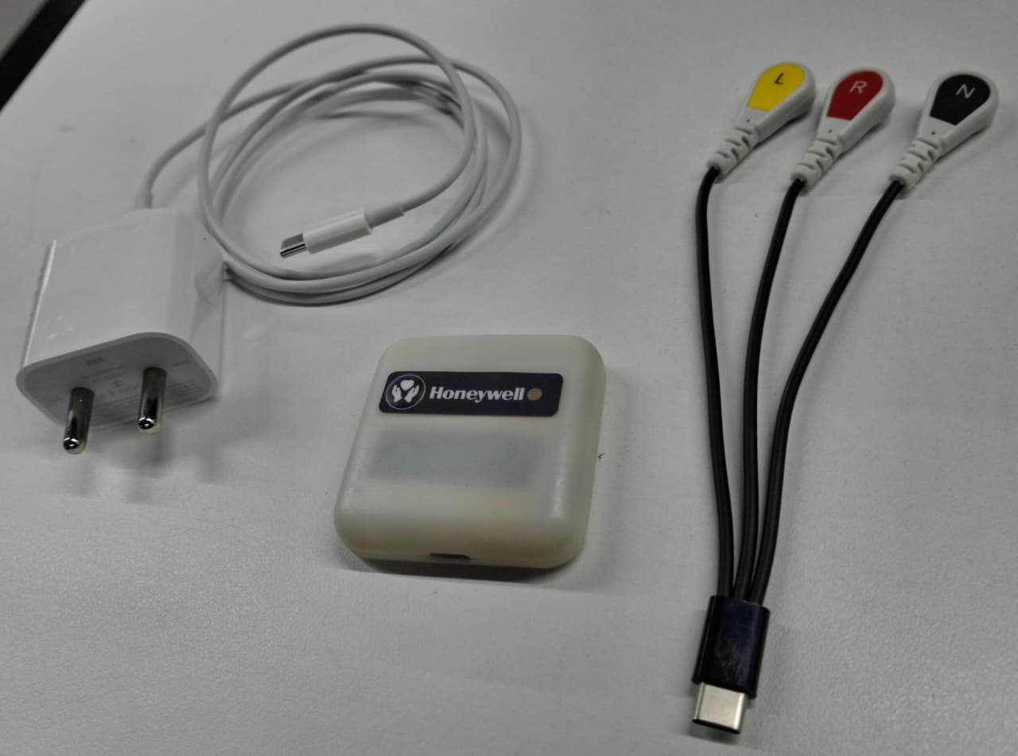
Commercials
MVO1 per device cost : 5450 INR per device
EBOM 4000 INR
MBOM 1250 INR
Packaging 100 INR
Adhesive Samples 100 INR

Slide 11
Development and Delivery Timeline MVO1
Functional Test
Integration Test
Wireless Radio Test
Battery Charge –Discharge Validation
Sample Test and Validation
27-Nov-2025
PCB FAB
Component Procurement
Enclosure Print
Gasket Production
EMS Finalization
Transfer to EMS
Production and Device Aassembly
12-Nov-2025
Hardware Readiness
2-Nov-2025
PCB FAB
Component Procurement
Enclosure Print
Gasket Production
EMS Finalization
Transfer to EMS
Weekly Dispatch
5 Feb 2025
Dispatch 10 Tested devices every week.
Receive Feedback and fix Bugs if any
First Batch Dispatch
4 DEC 2025
Pack and Dispatch 10 Tested Units

Slide 12






Communication Plan
Device Support
Configuration Support
Honeywell
Narayana
Tech Support and periodic Calls/Engagements

Slide 13
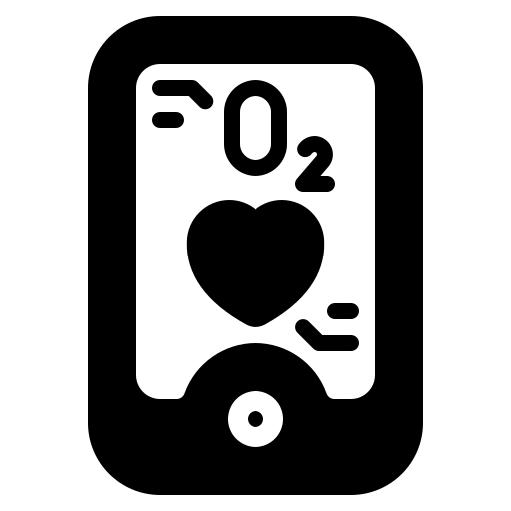
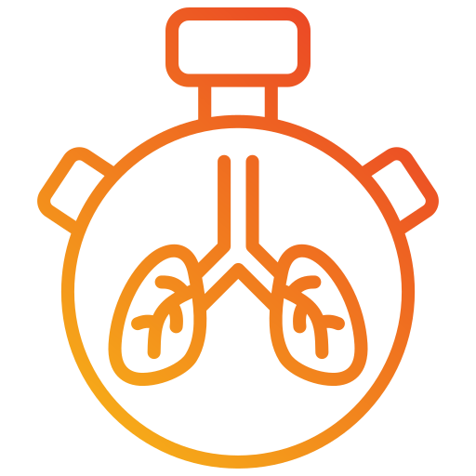

MVO Description
MVO2 + SPO2
MVO3
MVO1 +
Respiration rate + Heart Rate Variability + Body Posture IPX4
MVO2
ECG | SKIN TEMPERATURE | RGB LED NOTIFICATION | WAKEUP BUTTON
MVO1

Slide 14
Thank You!

